Slide 1
Saving the planet
Microbes for people, bees, soil and processing waste
Greg Gloor
Biochemistry, UWO

Slide 2
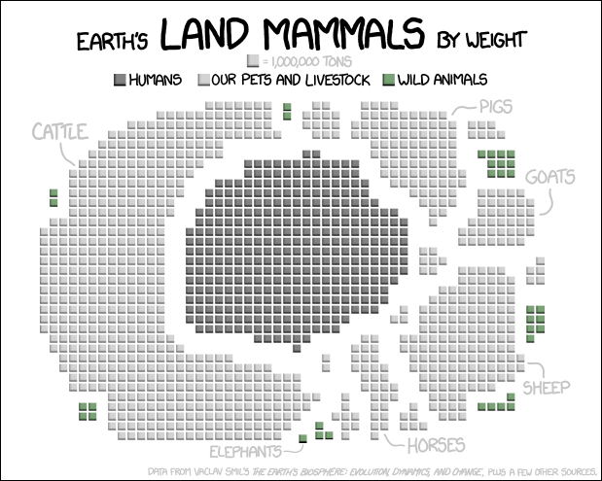
A sense of proportion
https://xkcd.com/1338/

Slide 3
A sense of proportion
https://en.wikipedia.org/wiki/Biomass_(ecology)

Slide 4
A sense of proportion
https://en.wikipedia.org/wiki/Biomass_(ecology)

Slide 5
A sense of proportion
https://en.wikipedia.org/wiki/Biomass_(ecology)

Slide 6
A sense of proportion
https://en.wikipedia.org/wiki/Biomass_(ecology)

Slide 7

Sometimes …
One bacterial type can make all the difference
Fermenting Solutions International

Slide 8
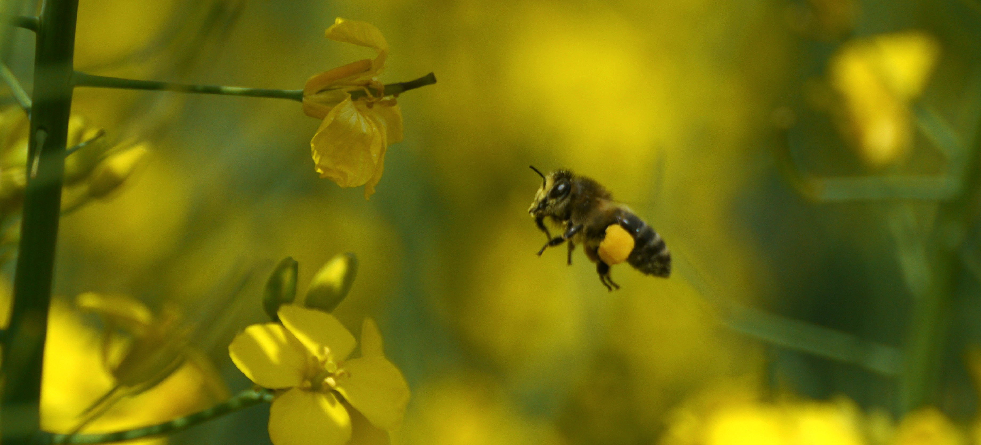
EU to fully ban neonicotinoid insecticides to protect bees
Reuters

Slide 9
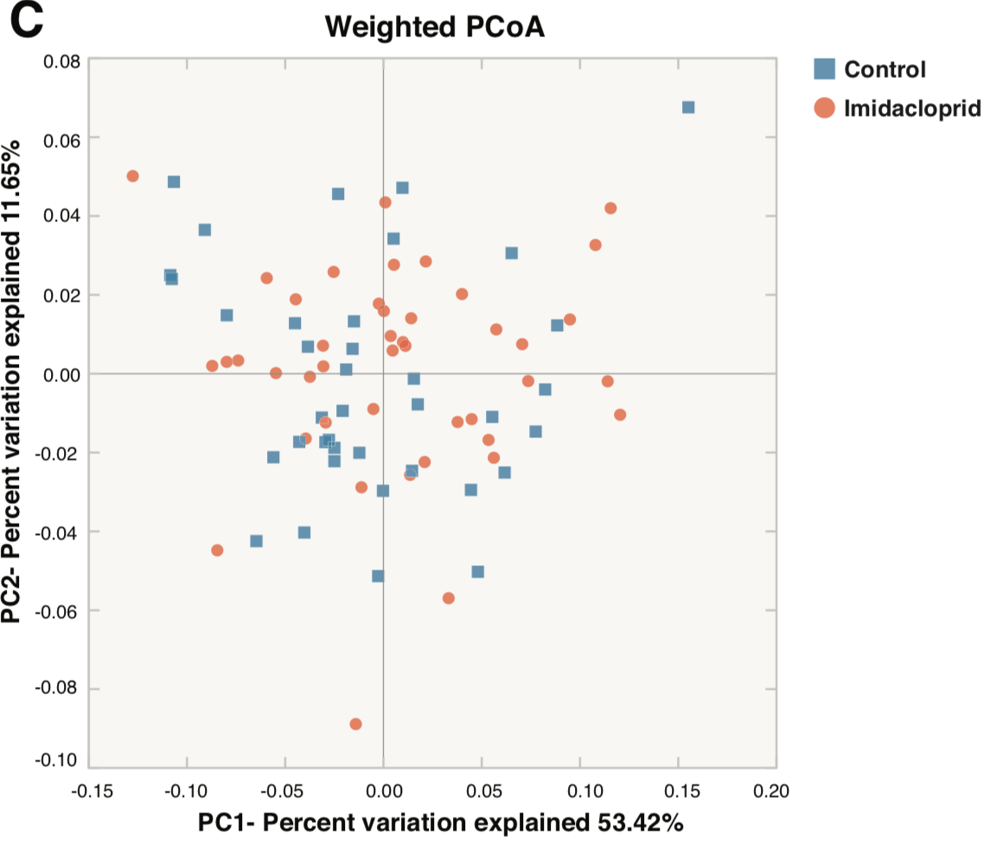
Raymann (2108) Imidacloprid decreases honey bee survival but does not affect the gut microbiome AEM

Slide 10
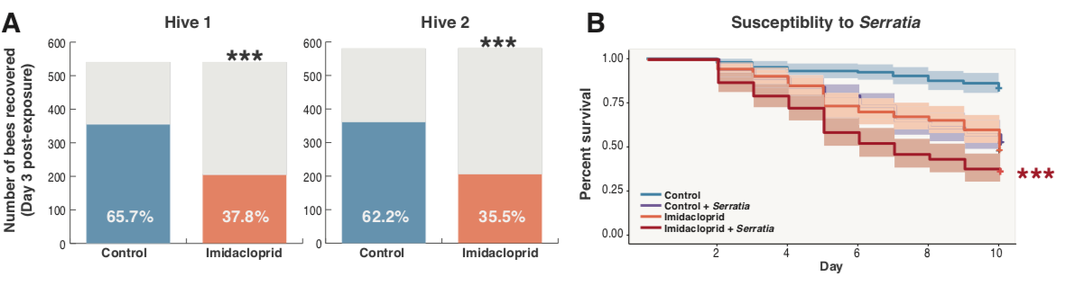
Raymann (2108) Imidacloprid decreases honey bee survival but does not affect the gut microbiome AEM

Slide 11
Raymann (2108) Imidacloprid decreases honey bee survival but does not affect the gut microbiome AEM

Slide 12
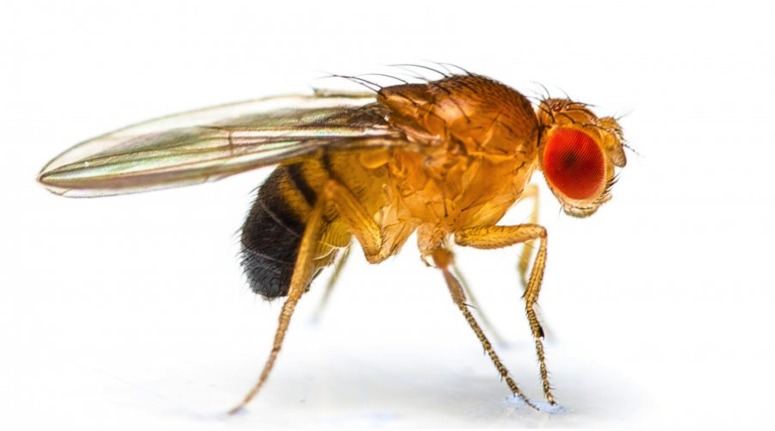
Daisley (2017) Neonicotinoid-induced pathogen susceptibility is mitigated by Lactobacillus plantarum immune stimulation in a Drosophila melanogaster model Sci. Rep.

Slide 13
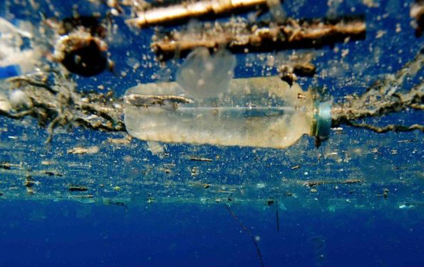
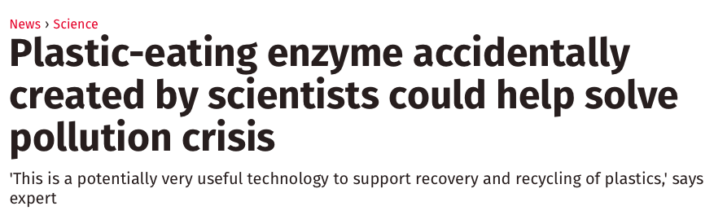
PET plastic

Slide 14
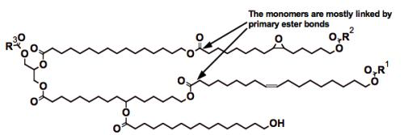
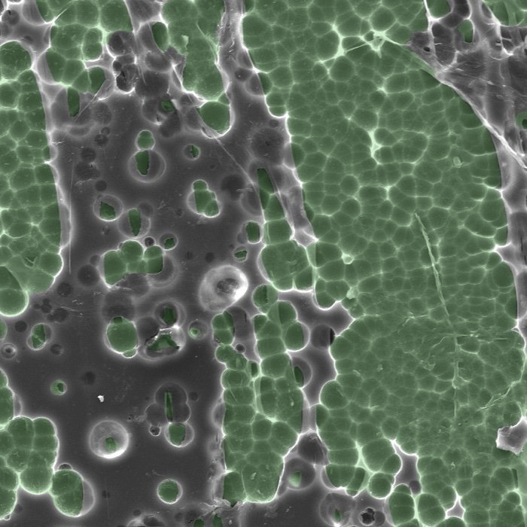
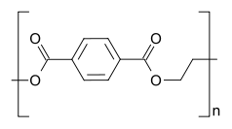
PET plastic and the magic enzyme
The enzyme degrading PET plastic (Dennis Schroeder/National Renewable Resource Laboratory)

Slide 15
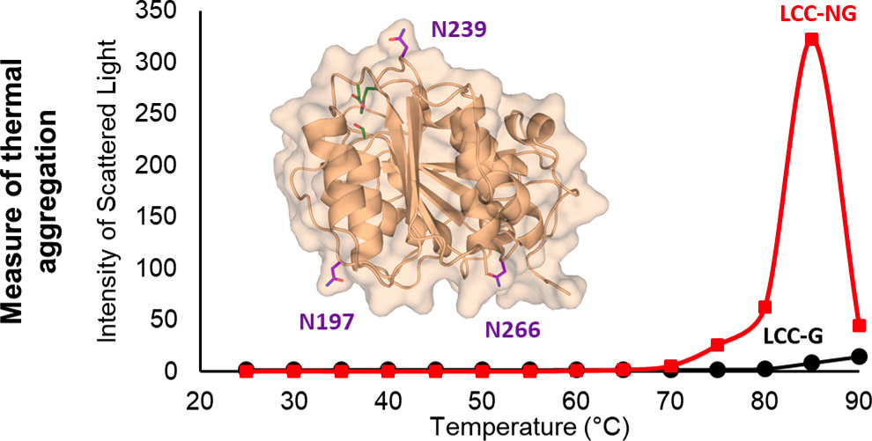
PET plastic and the magic enzyme
Shirke (2018) Stabilizing Leaf and Branch Compost Cutinase (LCC) with Glycosylation: Mechanism and Effect on PET Hydrolysis. Biochemistry

Slide 16

But usually …
It takes an ecosystem

Slide 17
Definition
A microbiome is a stable assemblage of micro-organisms and their genes that co-operate and compete (with themselves and the substrate)

Slide 18
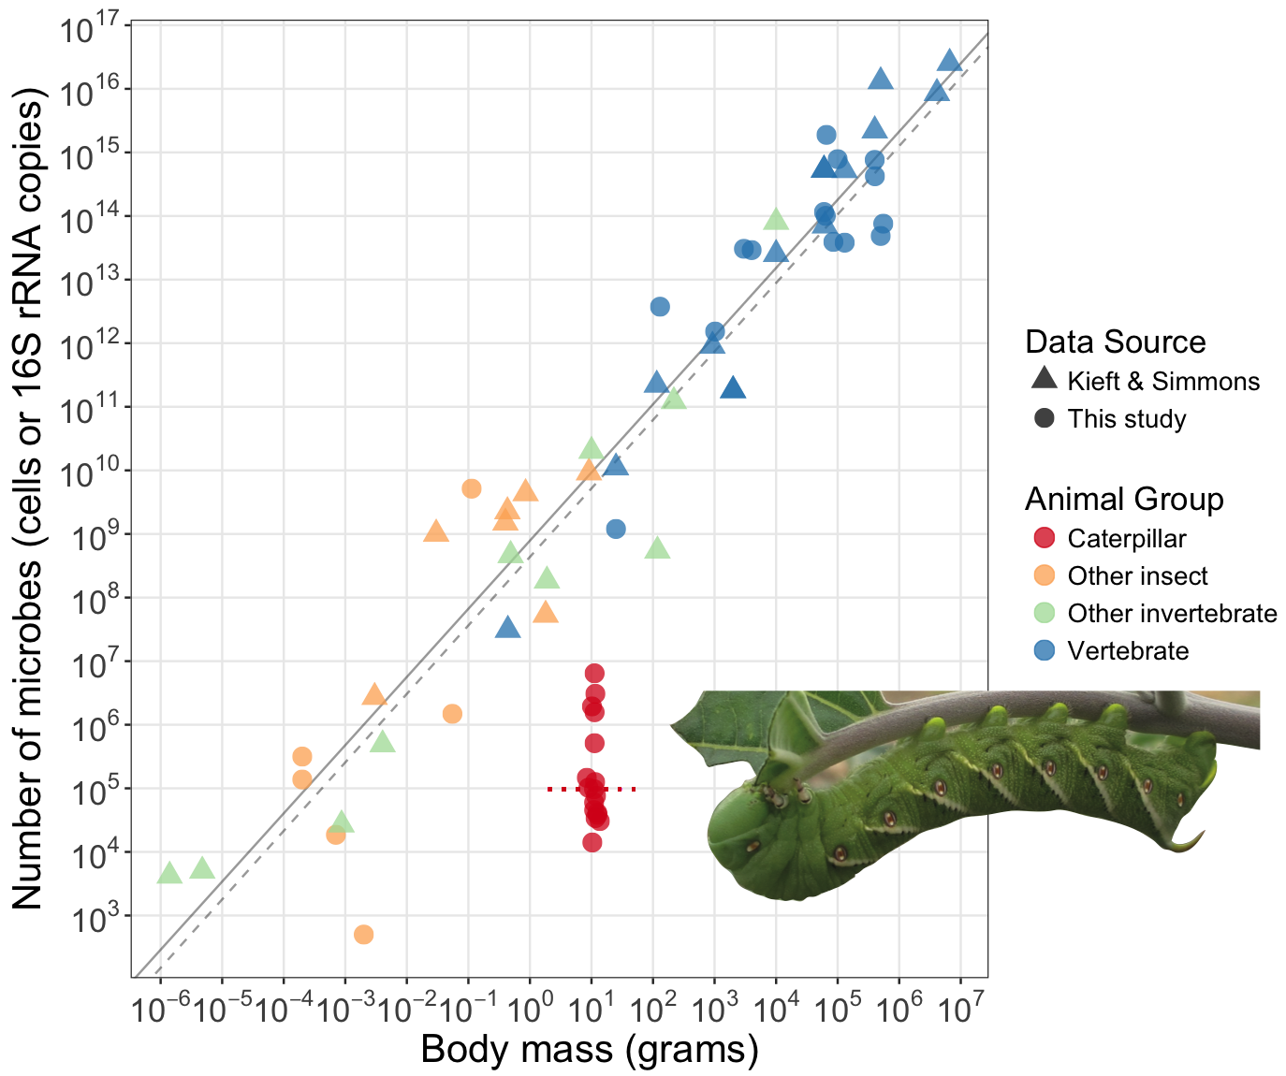
How to recognize a microbiome
Observable
Stable
Functional
Hammer (2017) Caterpillars lack a resident gut microbiome PNAS 114:9641

Slide 19
How to recognize a microbiome
Observable
Stable
Functional
Hammer (2017) Caterpillars lack a resident gut microbiome PNAS 114:9641

Slide 20
How to recognize a microbiome
Observable
Stable
Functional
Hammer (2017) Caterpillars lack a resident gut microbiome PNAS 114:9641

Slide 21
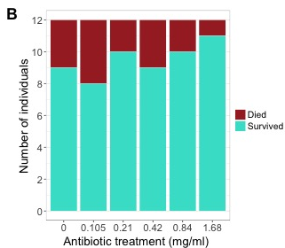
How to recognize a microbiome
Observable
Stable
Functional
Hammer (2017) Caterpillars lack a resident gut microbiome PNAS 114:9641

Slide 22
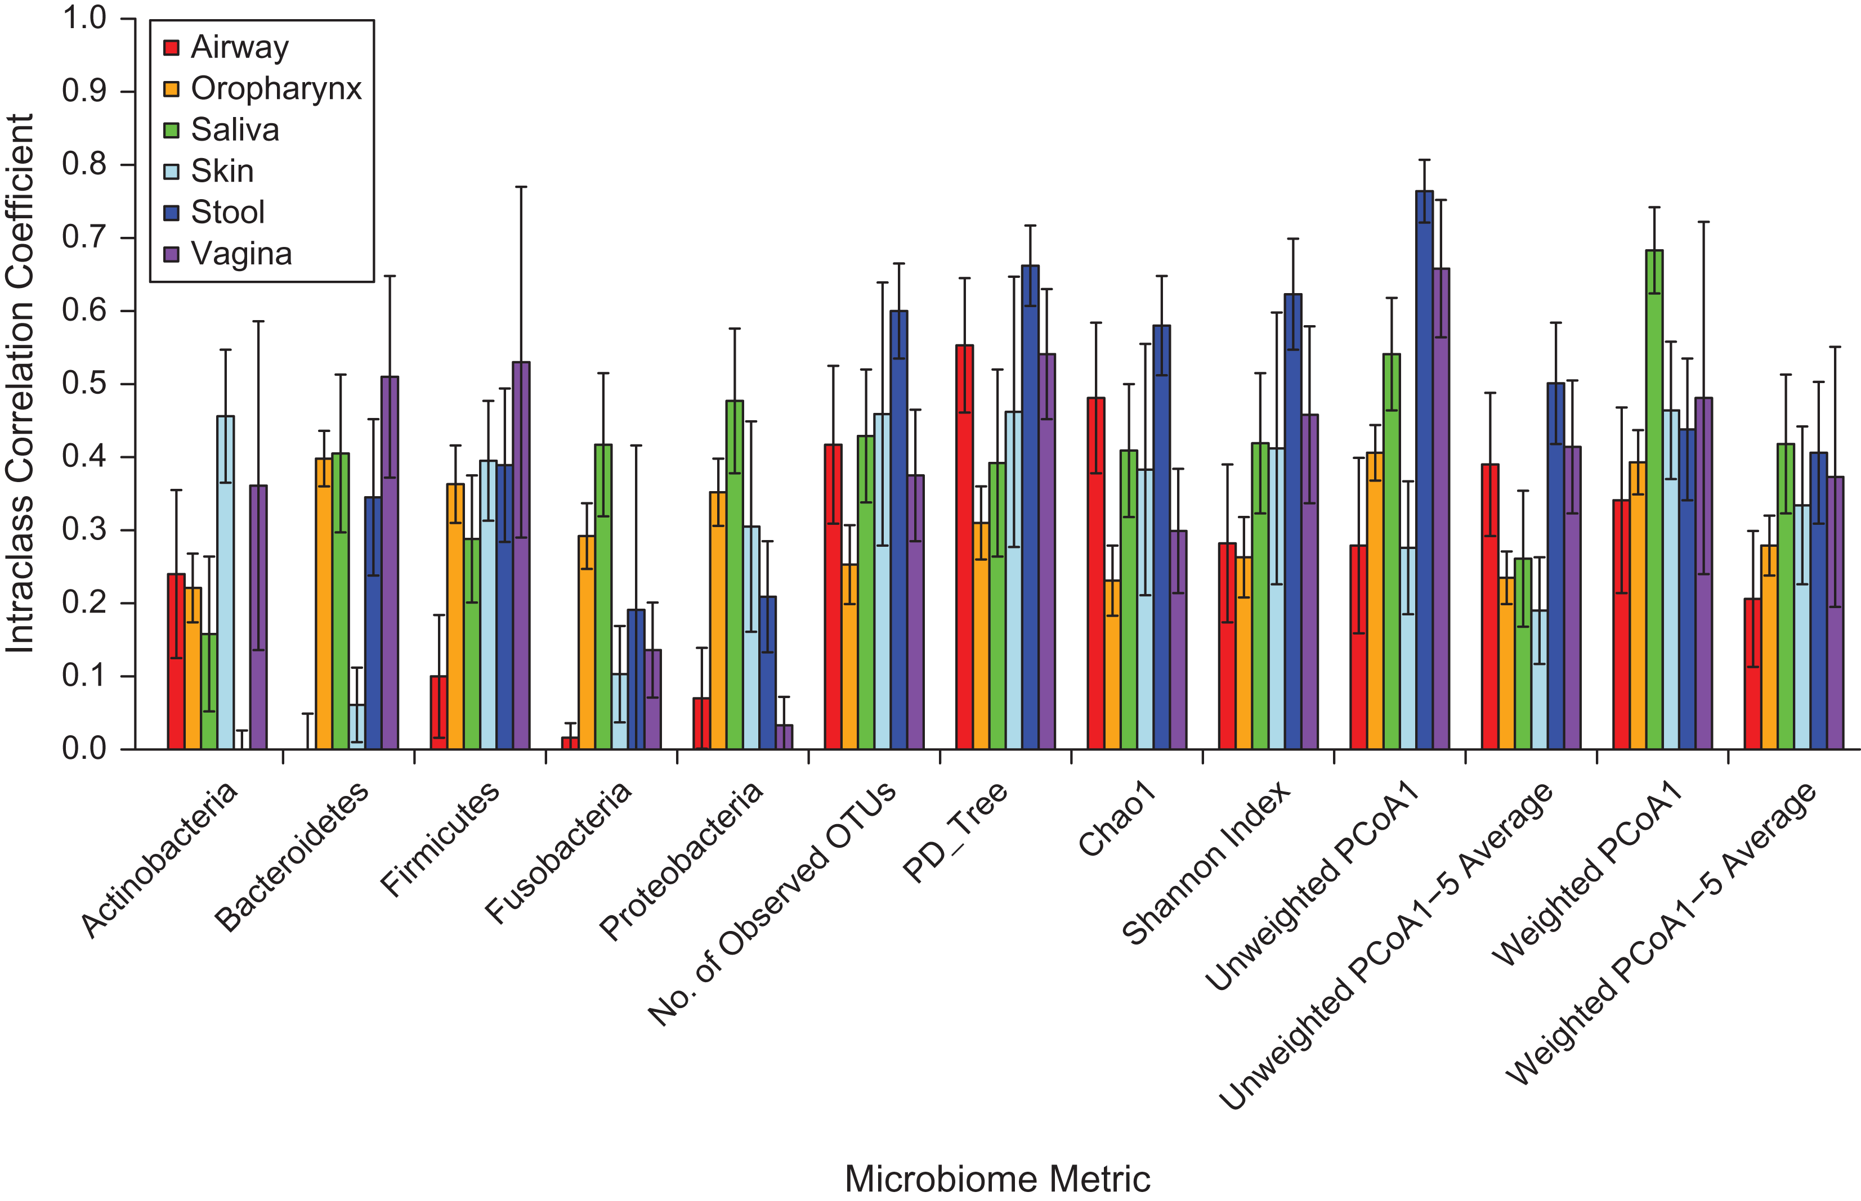
Do we have a microbiome?
Observable
Stable
Functional
Sinha (2017) Quantification of Human Microbiome Stability Over 6 Months: Implications for Epidemiologic Studies. A. J. Epi

Slide 23
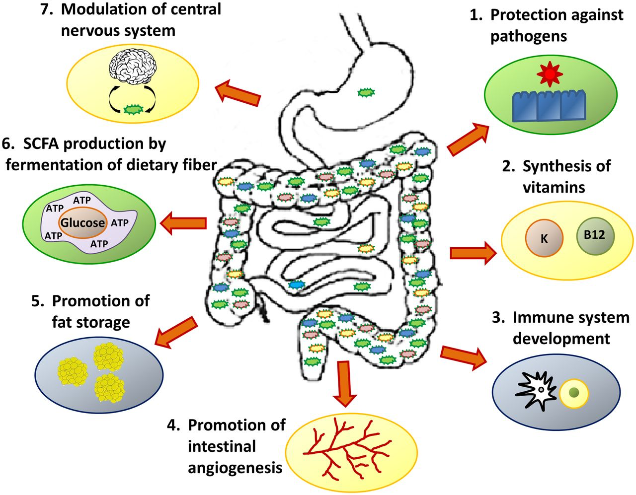
Do we have a microbiome?
Observable
Stable
Functional
Amon (2016) What is the microbiome? ADC Education and Practice

Slide 24
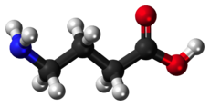
Levels of analysis

Slide 25
Function trumps taxonomy
Fernàndez (1999). How stable is stable? Function versus community composition. Appl. Environ. Microbiol. 65, 3697–3704.
Langenheder (2005). Weak coupling between community composition and functioning of aquatic bacteria. Limnol. Oceanogr. 50, 957–967.
Macklaim (2013) Comparative meta-RNA-seq of the vaginal microbiota and differential expression by Lactobacillus iners in health and dysbiosis Microbiome 1:12

Slide 26
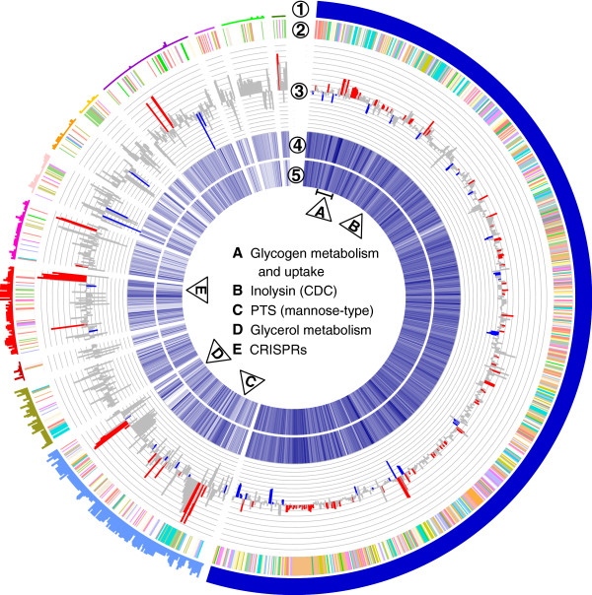
It’s the pan-genome!
16S
Macklaim (2013) Comparative meta-RNA-seq of the vaginal microbiota and differential expression by Lactobacillus iners in health and dysbiosis Microbiome 1:12

Slide 27
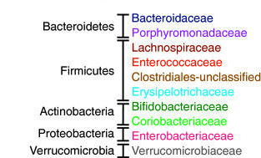
Ecosystem therapeutics for Clostridium difficile
PC2 18%
PC1 47%
Petrof (2013) Stool substitute transplant therapy for the eradication of Clostridium difficile infection: ‘RePOOPulating’ the gut Microbiome 1:3
Petrof (2013) Microbial ecosystems therapeutics: a new paradigm in medicine?, Ben. Microbes 4:53

Slide 28
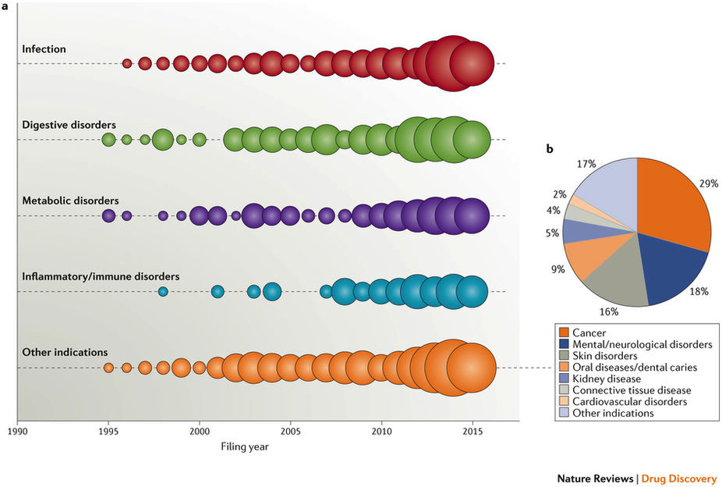
Modulating the human microbiome

Slide 29
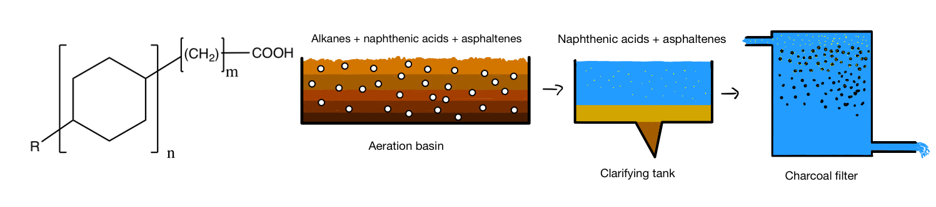
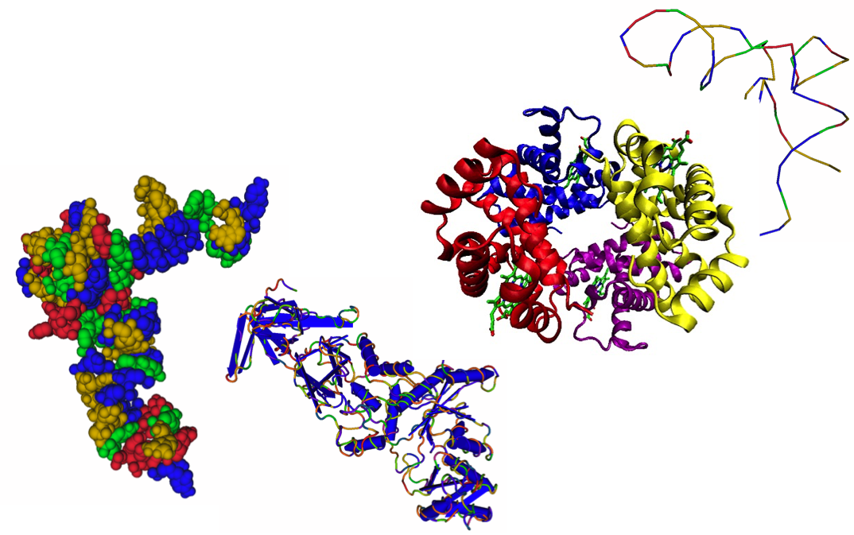
Waste-water
Alkane degradation
PAH degradation
Jean Macklaim, Tom Mcmurrough, Dan Giguere

Slide 30
Waste-water
Dan Giguere

Slide 31
Maize endophytic microbiome
Is modifiable
(Front Microbiol. 2017; 8: 11.)
Correlates with genotype
figshare.com/articles/Composition_of_the_Maize_Endophytic_Microbiome_is_Correlated_with_Maize_Genotype)
BMC Microbiology201414:332
Is antifungal
Front. Plant Sci., 06 October 2015 | https://doi.org/10.3389/fpls.2015.00805
Correlates with root microbiome
https://www.frontiersin.org/articles/10.3389/fmicb.2018.00484

Slide 32
The ideal case
Jean Macklaim

Slide 33
Back to reality
Jean Macklaim

Slide 34
Summary
Single bacterial types can have a big effect
But usually, it’s the ecosystem!
Sometimes we just have bacteria, sometimes we have a microbiome
Function is more useful than taxonomy

Slide 35
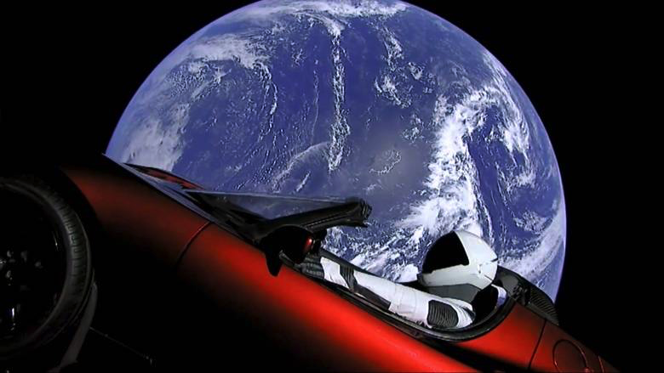
Moral of the story …
The planet will be just fine if we disappear – we need to harness the microbiome to save ourselves!

Slide 36
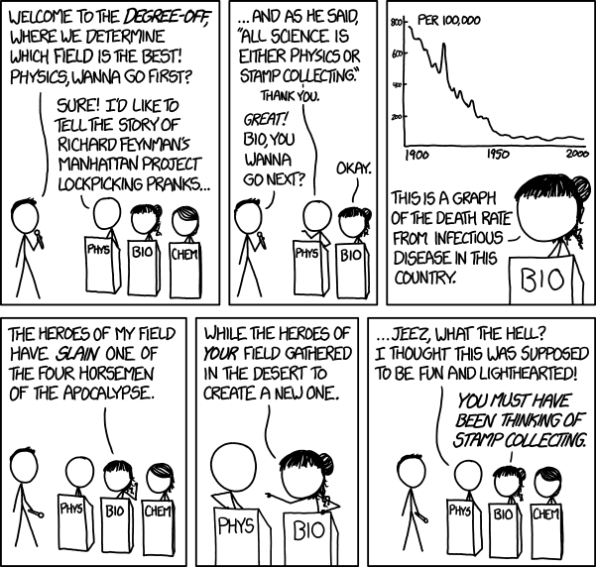

Saving the planet?
The planet will be just fine if we disappear – we need to harness the microbiome to save us!

